Slide 1

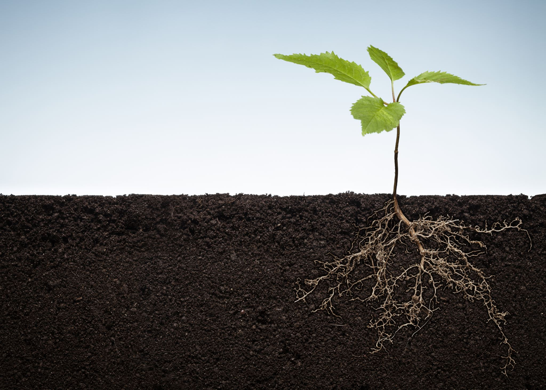
ENRIQUE GASPAR FEDERICO MENDOZA HECTOR CONTRERAS DANIELY MIRANDA
Coding Boot Camp- Project One
Tuesday February 4th, 2020

Slide 2
If we measure the social indexes of the most developed countries, then we will conclude that those that have better social indexes will have lower environmental impact levels. Because a high social index, provides a basis for improving environmental governance, enforcing environmental-focused laws that prioritizes the goal of improving the protection and preservation of our natural environment. *Developed countries: lower level on the GINI Index and high level of Rule of Law
HYPOTHESIS

Slide 3



Step 1: Decompose the “Ask”
Which OECD* Countries had the most environmental impact in the last 2 decades:
México (High Gini) or Finland (Low Gini)?
*30 OECD Countries before 2000

Slide 4


Step 1: Decompose the “Ask”
For the OECD countries, which socio-economic factors have the most impact on the environment?
Which countries are members of the OECD?
What are the indexes that determine the degree of development in a country?
What does GINI Index and Rule of Law mean?
How can we connect the social indexes with the preservation of our natural environment?
What environmental factors change based on the countries’ social indexes?

Slide 5

Step 2: Identify Data Sources
We obtained the data of the 14 variables from the World Bank
GDP Per Capita
C02 Emissions (Tn per capita)
Rule Of Law
Acces to Electricity
C02 Emissions
Forest Area (km2)
Methane Emissions
Urban Population
Forest Area (% of land)
Population Growth
GINI Index
Renewable Energy Consumption
GDP Growth
Total Greenhouse Gas Emission

Slide 6
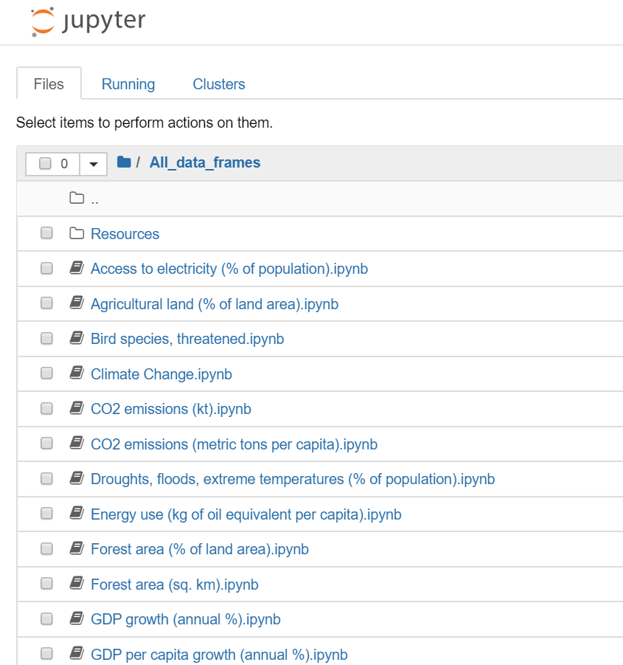
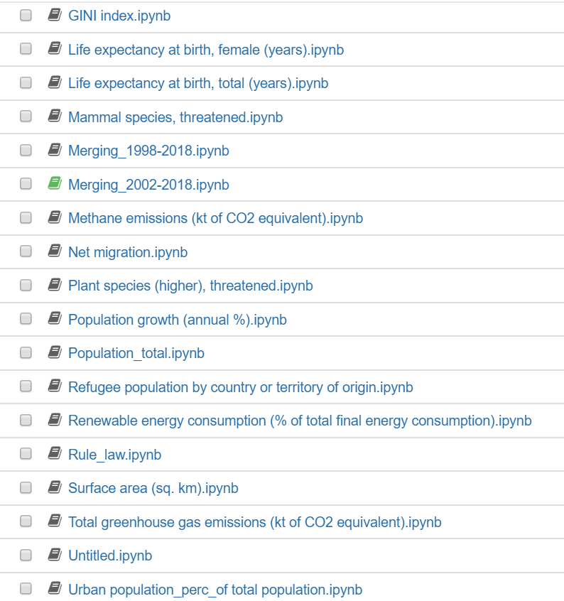
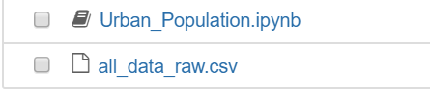
Step 3: Define Strategy and Metrics
From the csv files downloaded from the World Bank, we read them using Pandas on a Jupyter Notebook to create DataFrames and cleaning them, so it would be easier to understand and analyze each database provided so we could merge them in a more efficient way
Search for the variables in the World Bank data platform
Download and save csv files of each data base
Import data into Jupyter Notebook using Pandas
Create DataFrames, and cleanse of information
Merging of DataFrames into a master DataFrame

Slide 7
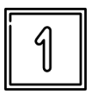
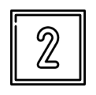
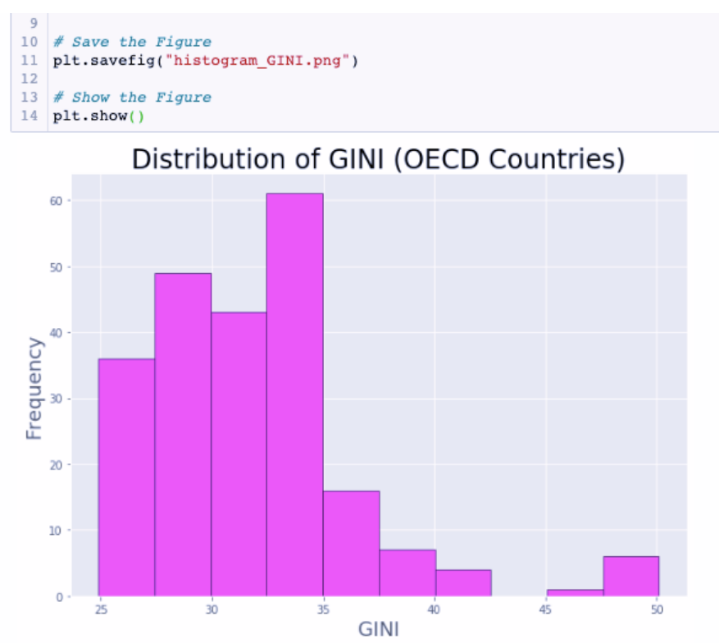
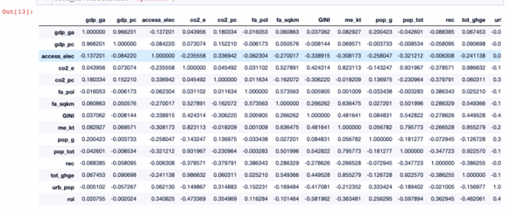
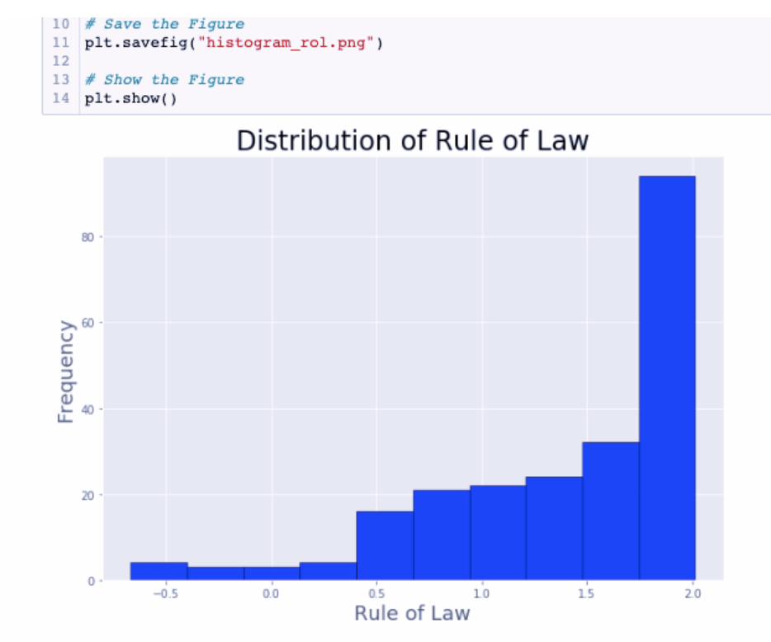
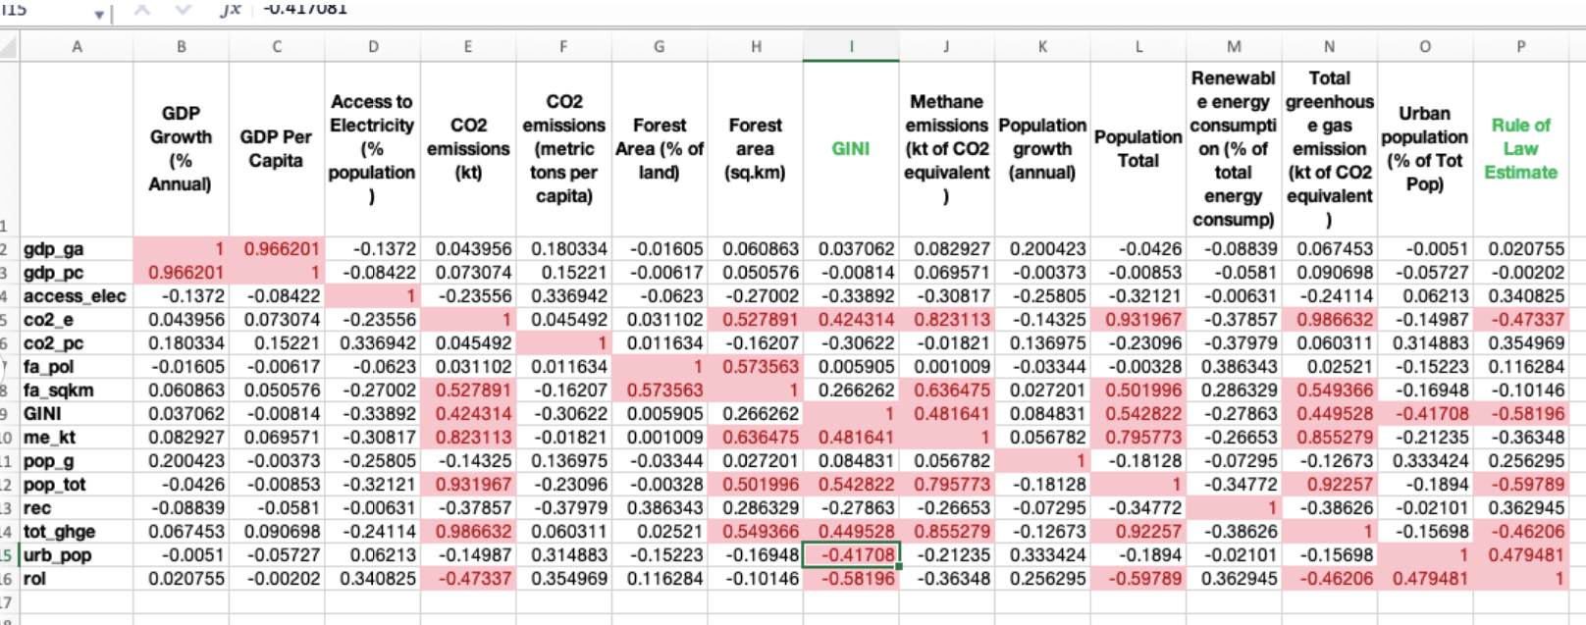
Step 4: Analyze for Trends
In order to analyze the trends of our master DataFrame, we ran a correlation analysis within the whole variable index that we thought could explain better our hypothesis
Variables Distribution
Correlation Analysis
After analyzing the descriptive data, and the data distribution we concluded that GINI and INDEX Rule of Law did not have a normal distribution, so the statistical tests are not parametric
Since the variables were not parametric, we used Spearman correlation. When using the spearman correlation, it can be seen that there is a moderate to strong correlation between the total emission of greenhouse gases (tot_ghge) and the two social variables: GINI and Rule of Law
Describe the análisis process (accompanied with Jupyter Notebook)
fterwards we run a correlation analysis within the whole variable index that we thought would explain better our hypothesis; by doing these analysis we observed that a bunch of variables had no correlation or where no significant to our research, base on the result we decided to take another path looking for the effect that our variables had on the OECD countries.
En los datos descriptivos nos dimos cuenta que GINI ni INDEX Rule of Law no tenian una distribucion normal, por lo que las pruebas estadisticas no son parametricas

Slide 8
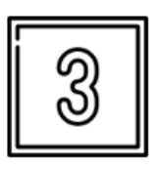
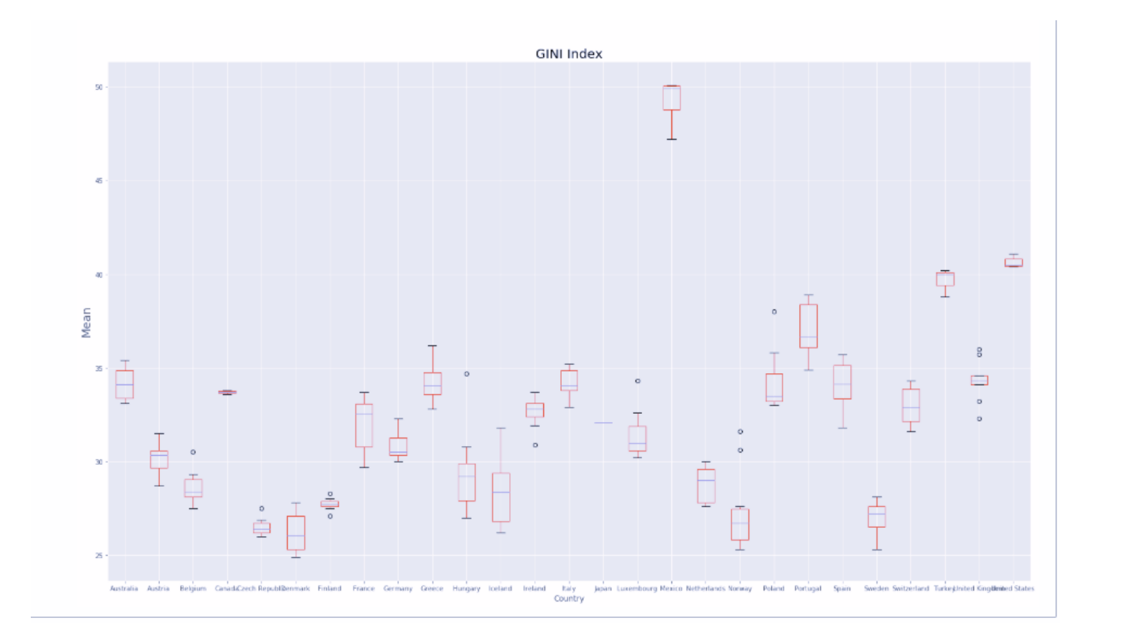
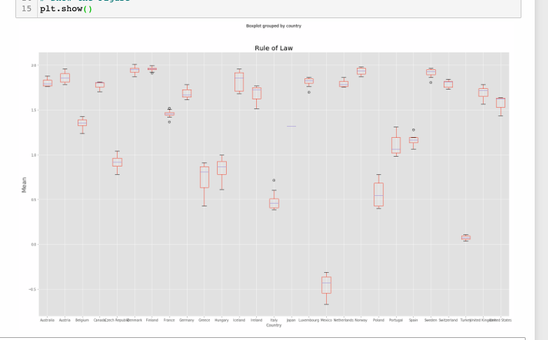
Step 4: Analyze for Trends
In order to analyze the trends of our master DataFrame, we ran a correlation analysis within the whole variable index that we thought could explain better our hypothesis
Box Plotting
Gini Index of OCED Countries
Rule of Law of OCED Countries
Mexico
Mexico
Describe the análisis process (accompanied with Jupyter Notebook)
fterwards we run a correlation analysis within the whole variable index that we thought would explain better our hypothesis; by doing these analysis we observed that a bunch of variables had no correlation or where no significant to our research, base on the result we decided to take another path looking for the effect that our variables had on the OECD countries.
En los datos descriptivos nos dimos cuenta que GINI ni INDEX Rule of Law no tenian una distribucion normal, por lo que las pruebas estadisticas no son parametricas

Slide 9
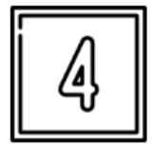
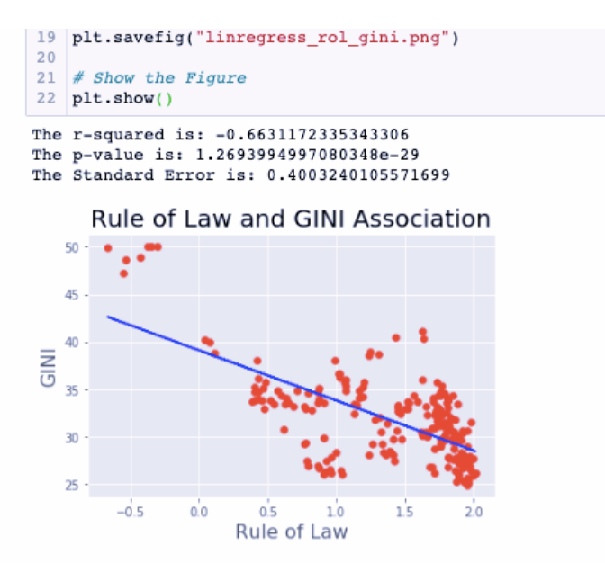
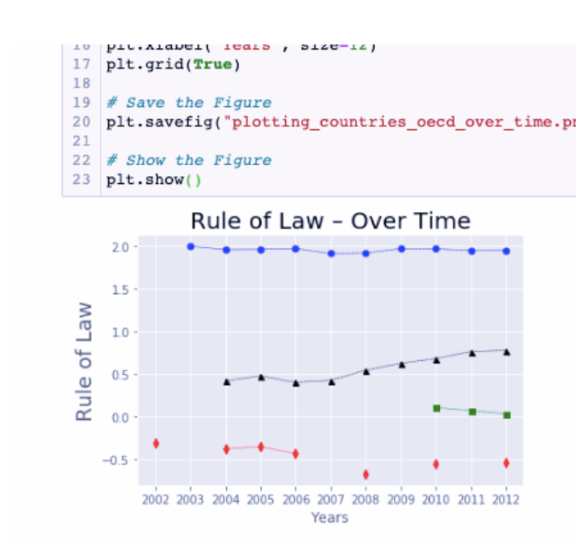
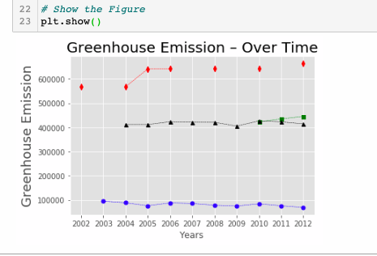
Step 4: Analyze for Trends
After running the correlation analysis, we ran the regression and analyze the trends to find out their contamination status
Regression & Trends
After analyzing the descriptive data, and the data distribution we concluded that GINI and INDEX Rule of Law did not have a normal distribution, so the statistical tests are not parametric
Since the variables were not parametric, we used Spearman correlation. When using the spearman correlation, it can be seen that there is a moderate to strong correlation between the total emission of greenhouse gases (tot_ghge) and the two social variables: GINI and Rule of Law
Describe the análisis process (accompanied with Jupyter Notebook)
fterwards we run a correlation analysis within the whole variable index that we thought would explain better our hypothesis; by doing these analysis we observed that a bunch of variables had no correlation or where no significant to our research, base on the result we decided to take another path looking for the effect that our variables had on the OECD countries.
En los datos descriptivos nos dimos cuenta que GINI ni INDEX Rule of Law no tenian una distribucion normal, por lo que las pruebas estadisticas no son parametricas

Slide 10
Step 5: Summary of Conclusions
With this Project we found out:
A Higher level of GDP on countries gives us a positive relation with GINI and RoL.
We found that even though there are developed countries in the OECD, it exists a positive correlation between the socio-economic factors and the green house emissions
Higher levels of GINI is positivitely corrleated with higher population.
Even though our results look like the most developed countries had the worst behavior on contamination, the RoL helps to keep the contamination levels low by using regulatory actions.

Slide 11
The End

